Slide 1


Job Market Analysis and Recommendation System
By Latha Payani
05/09/2025

Slide 2
Project Tasks and Deliverables
Tasks
Deliverables
1.Analyze the correlation between job title keywords and offered salaries
.
2.identify emerging job categories based on posting frequency
3.Predict high-demand job roles by analyzing job posting patterns over time
5. Create a job recommendation engine based on current job postings
7.Investigate trends in the remote work landscape
8. Predict future job market trends
A report detailing the correlation, supported by statistical analysis and visualizations
A predictive analytics report with potential future scenarios
4.Compare average hourly rates across different countries
6. Track changes in job market dynamics over months
A predictive model with accuracy metrics, and a visual representation of demand trends over time.
An interactive map or chart showing hourly rates by country.
A working prototype of the recommendation engine, API documentation, and a user interface for interaction.
A comprehensive report on remote work trends with data-backed forecasts
A dashboard that updates monthly with new trends in the job market
A list of emerging job categories with growth analysis over time.

Slide 3
Data Pre-processing Handling Missing Values and Outliers
Loading data
Loaded given data into a pandas Data Frame to perform all the tasks
Standardize
Normalized text fields, Standardize measurement units
Data Validation
Implement checks to ensure data meets quality standards before analysis.
Handling Missing Values
Identified and removed missing values by use of median and mode.
Outliers
Used IQR method to Handled outliers
Removed Duplicate Values
By Using fillna() I have removed duplicates in data

Slide 4
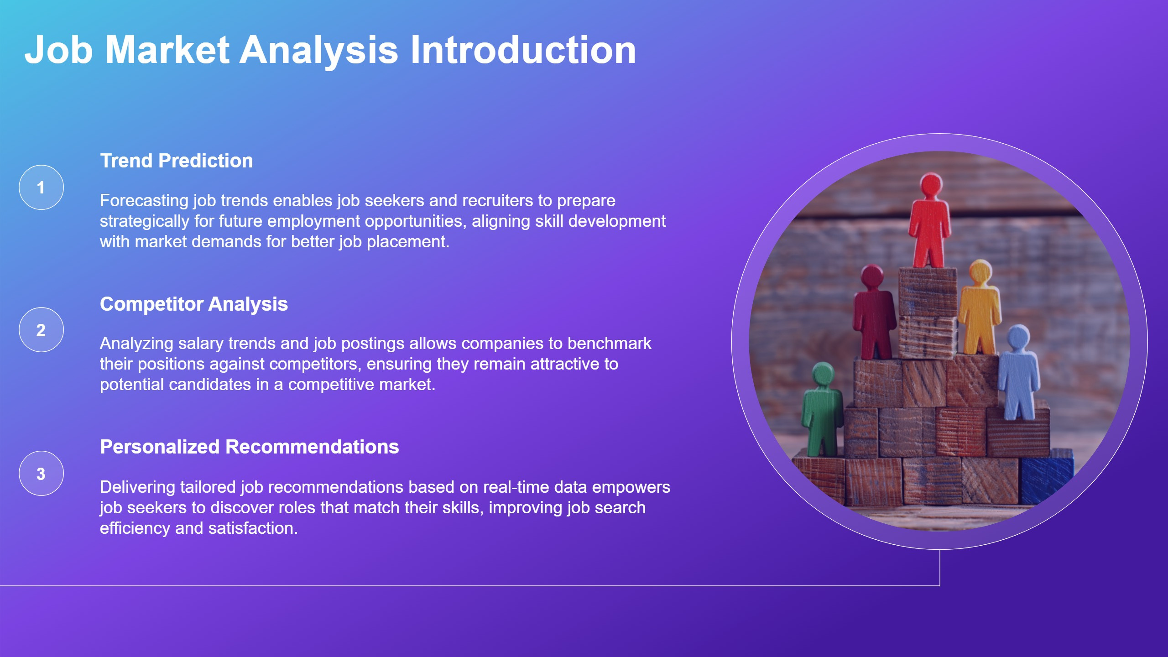

Slide 5
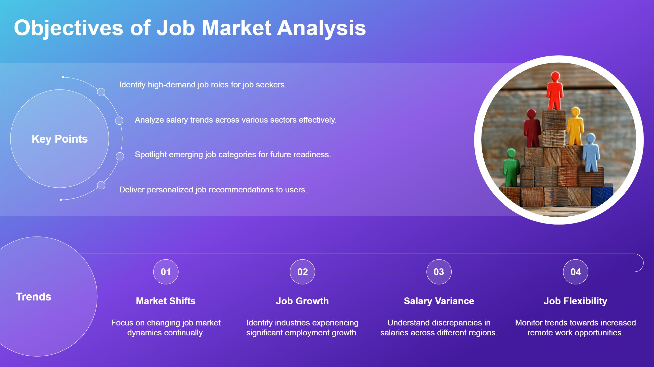


Slide 6
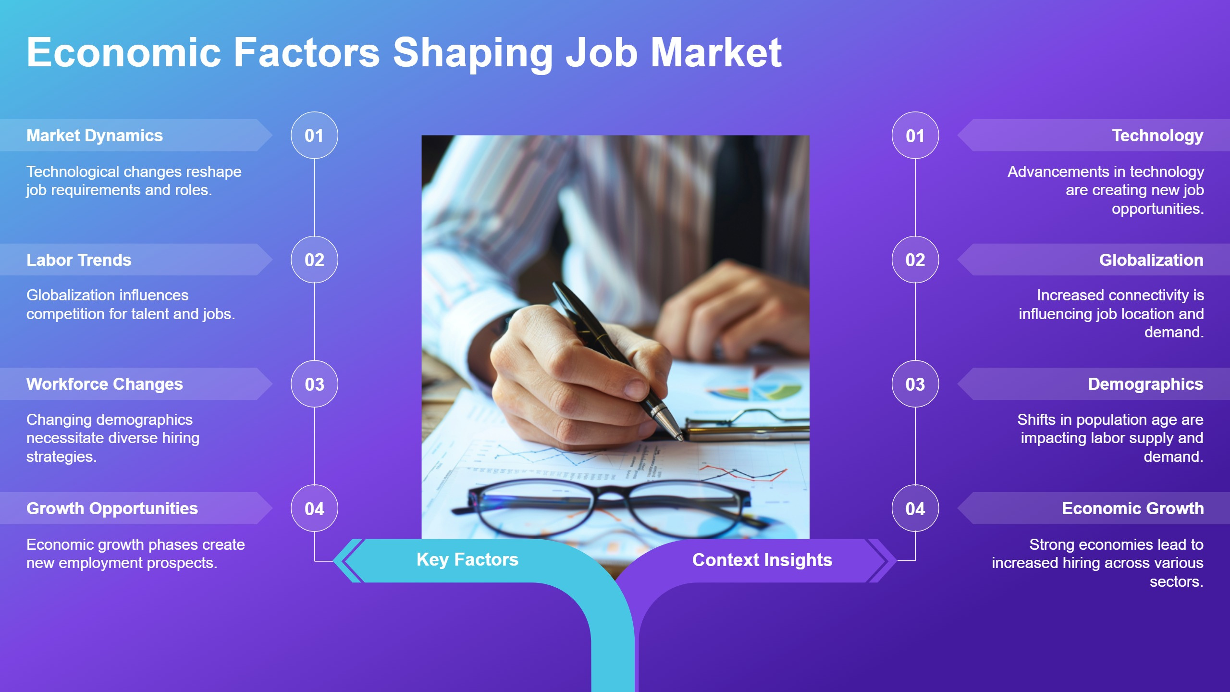


Slide 7
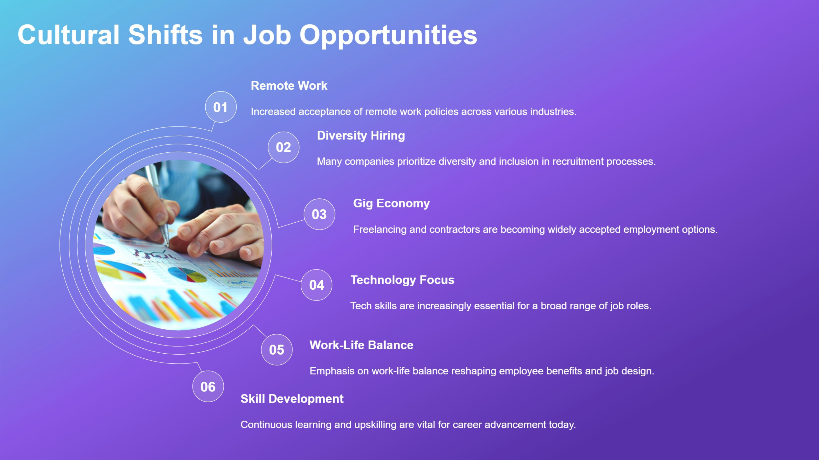

Slide 8
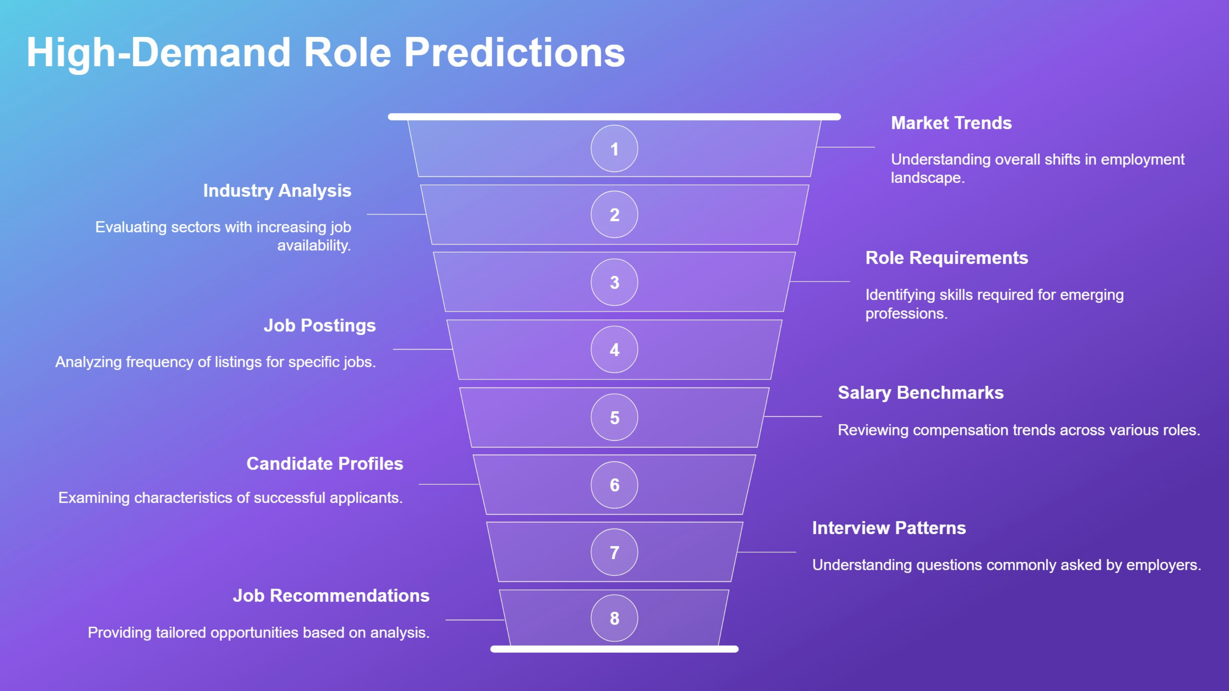

Slide 9
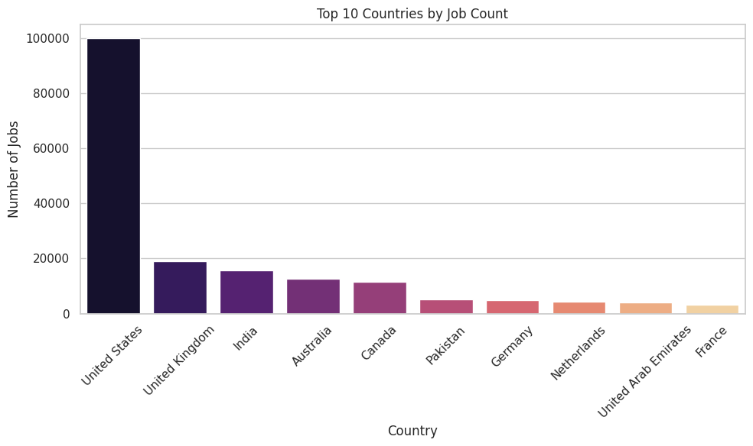
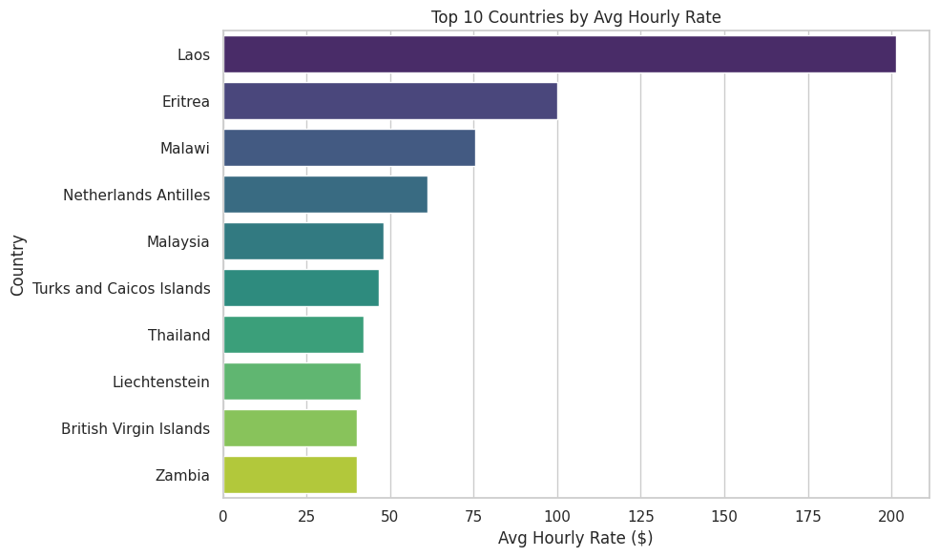
Graphical representation

Slide 10
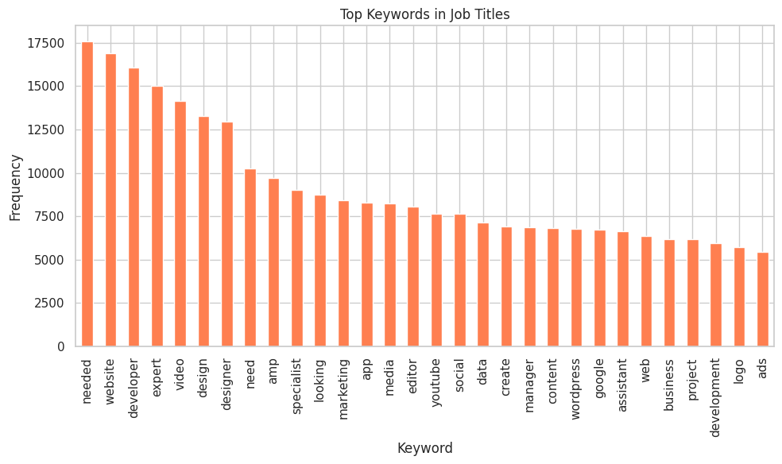
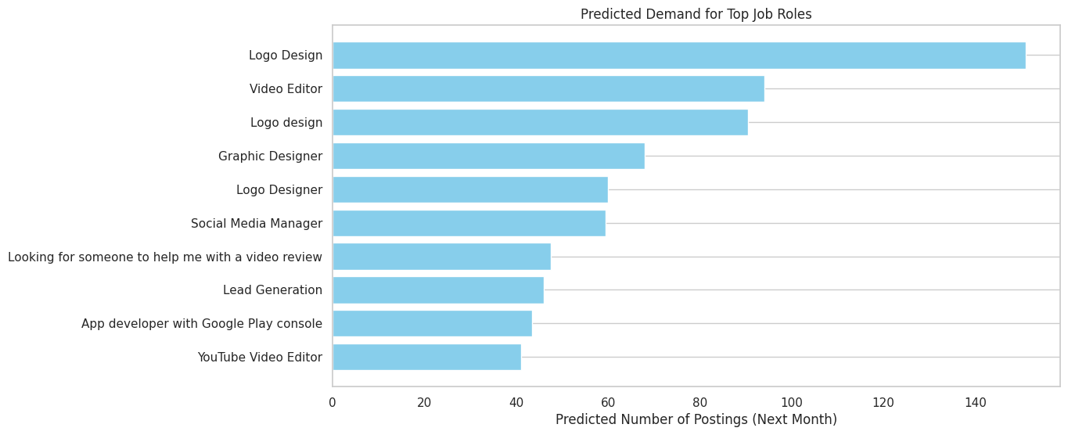

Slide 11
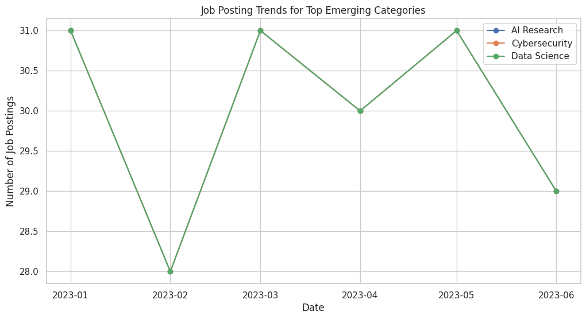
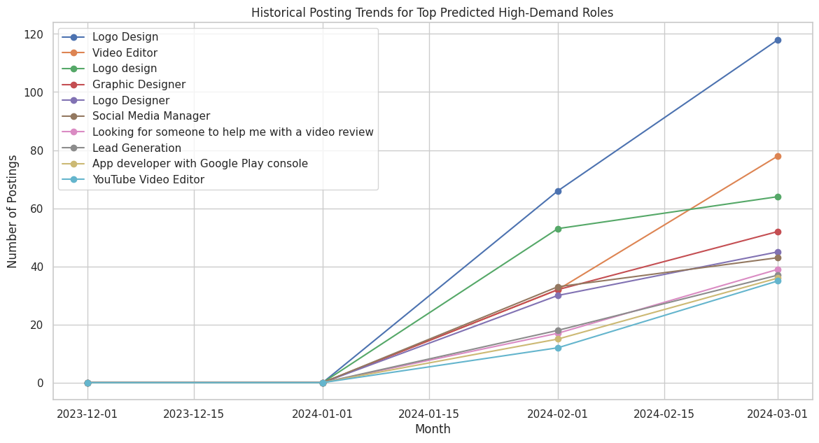

Slide 12
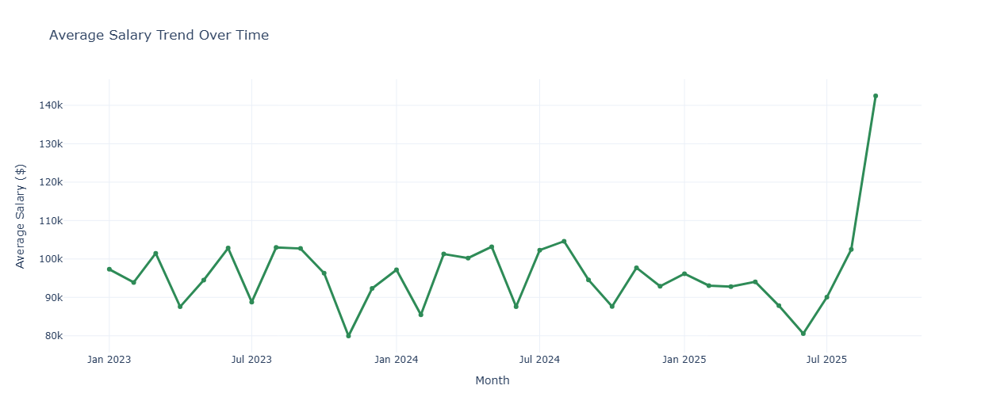
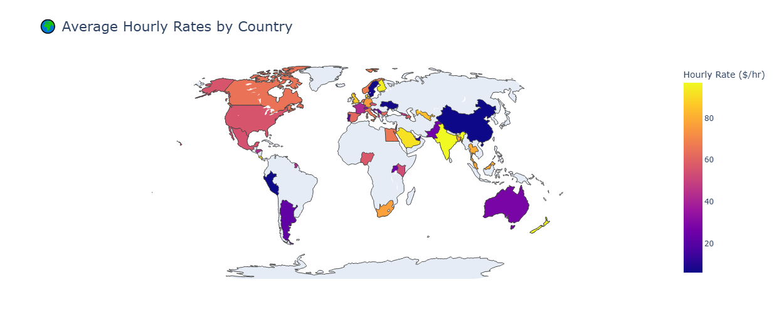

Slide 13
Key Accomplishments
Extracted keywords from thousands of job titles and uncovered their impact on salary levels.
Discovered fast-growing job categories by analyzing posting frequency over time.
Built forecasting models to predict future demand for specific job roles.
Compared hourly wage trends across countries to identify global salary disparities.
Identified key features required for matching users to relevant job listings.
Prepared data insights for potential dashboard integration and tracking.
Analyzed the shift toward remote work and its adoption across different sectors.
Predicted upcoming changes in the job market using historical data.
1
2
3
4
5
6
7
8

Slide 14
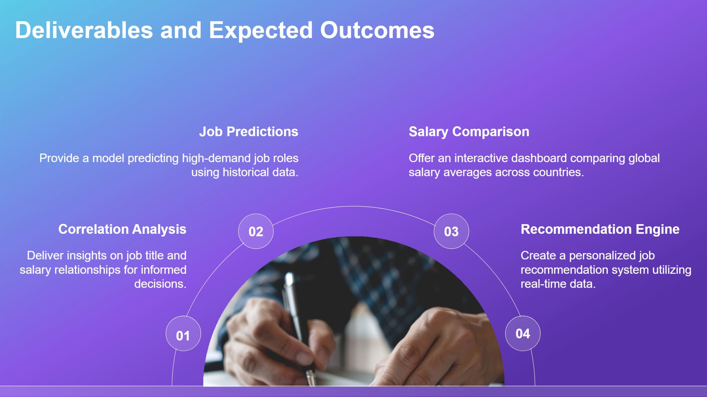

Slide 15
Thank You

